Slide 1

PLANT RESPONSES TO THE BIOTIC ENVIRONMENT
Year 13 Biology

Slide 2
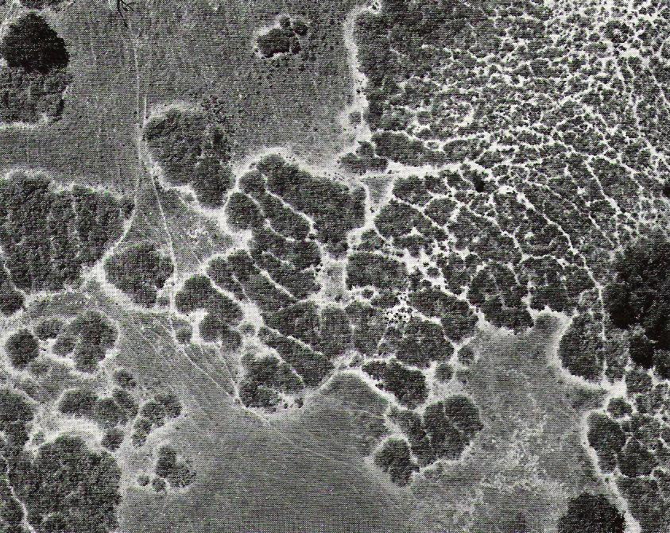
Chaparral bush allelopathy

Slide 3
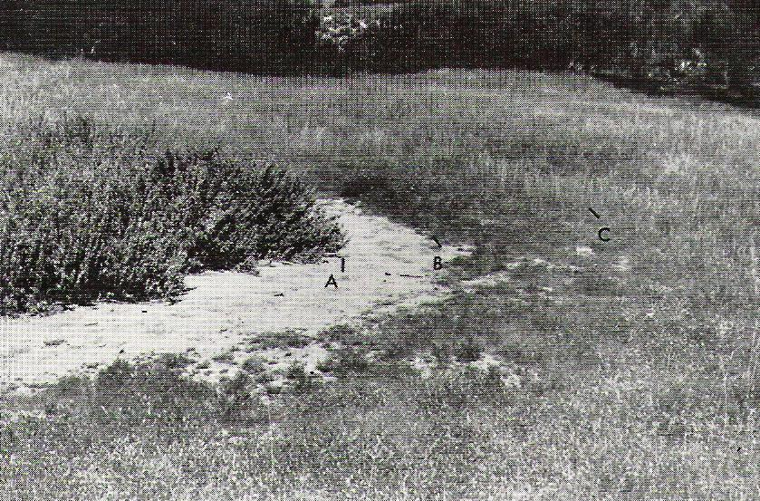
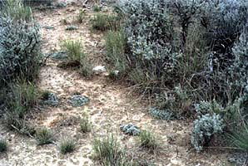
Chaparral bush allelopathy
Allelopathy – a form of antibiosis in which one plant secretes toxins into the surrounding soil that stops others growing.

Slide 4
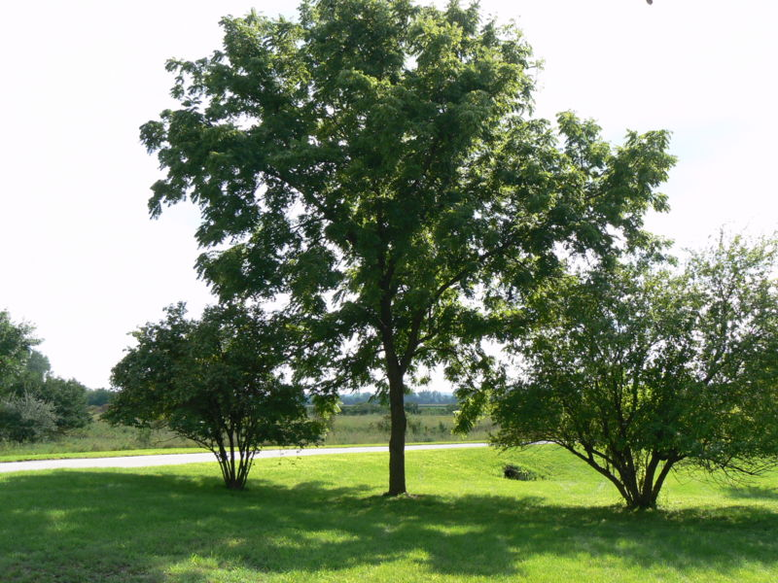
Allelopathetic! –
Walnut secretes juglone

Slide 5
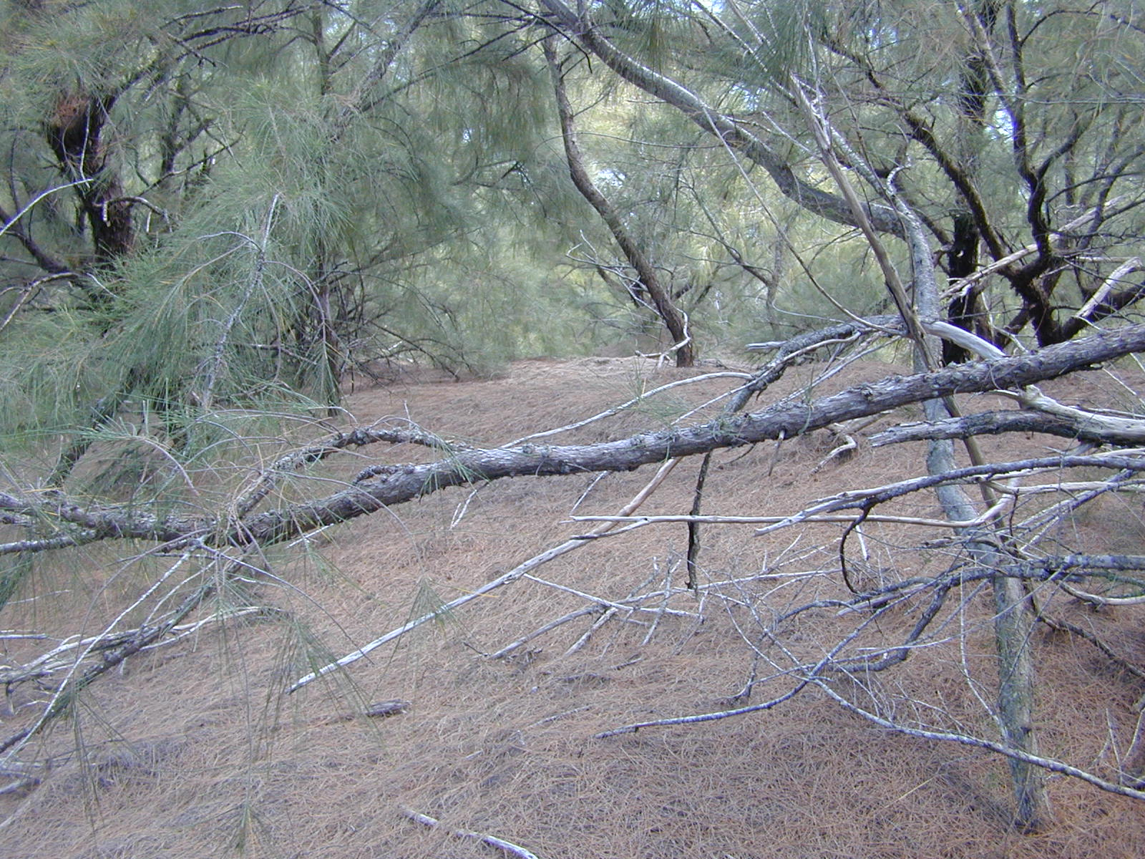
Allelopathy again - Casurina

Slide 6
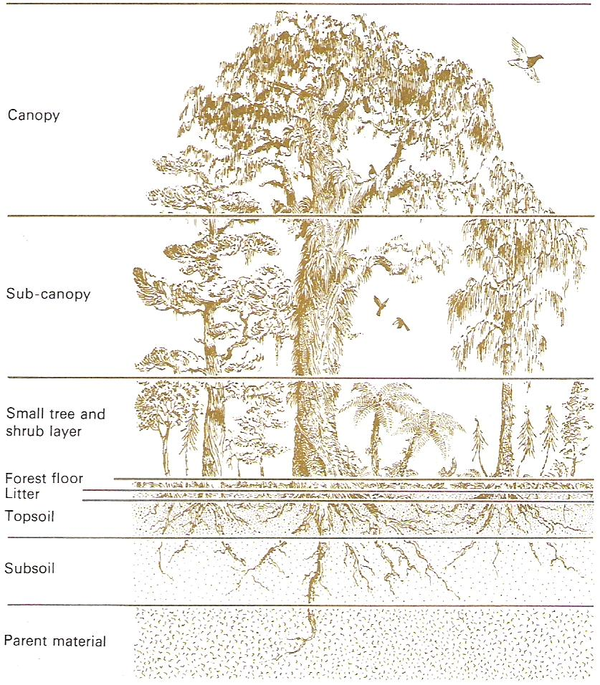
Stratification
Large trees change conditions beneath them creating micro-climates resulting in vertical layering

Slide 7
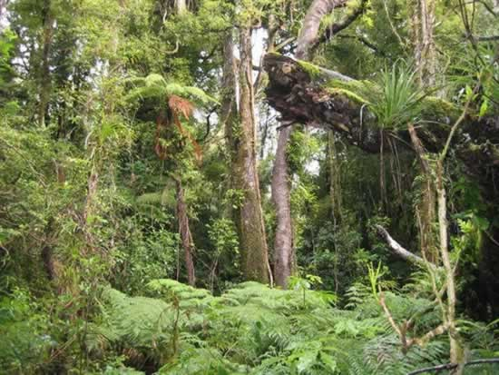

Slide 8
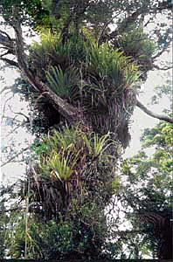
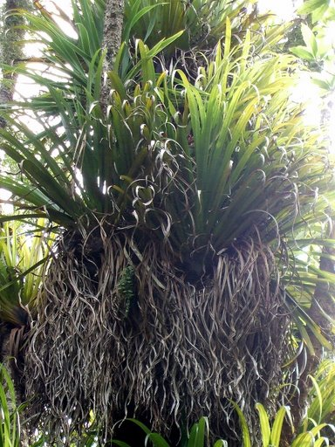
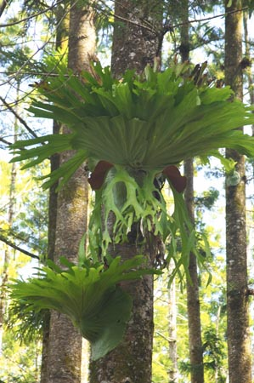
Epiphytes - Perching Lilies and staghorn fern

Slide 9
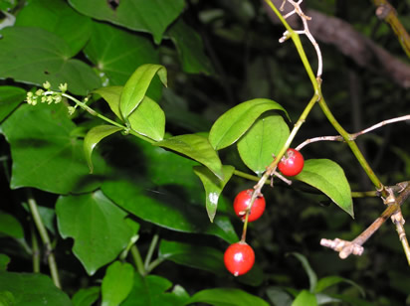
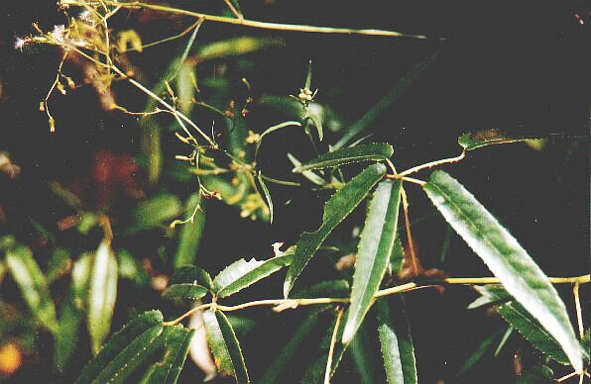
Lianas –climbing vines
Supplejack Bush lawyer

Slide 10
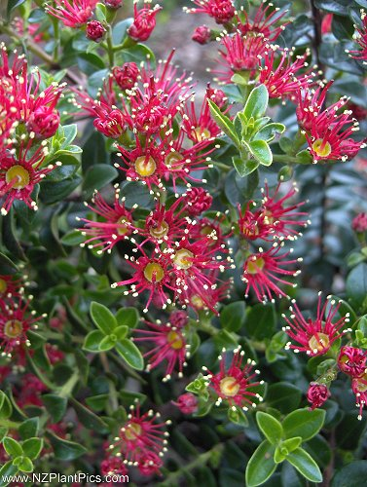
Climbing Rata

Slide 11
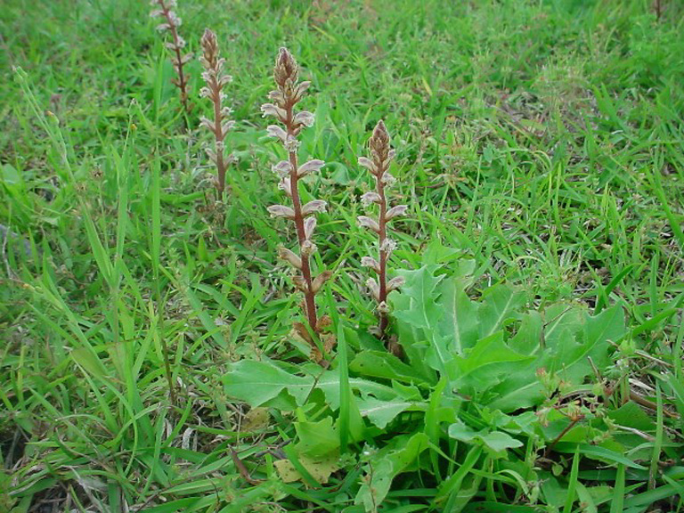
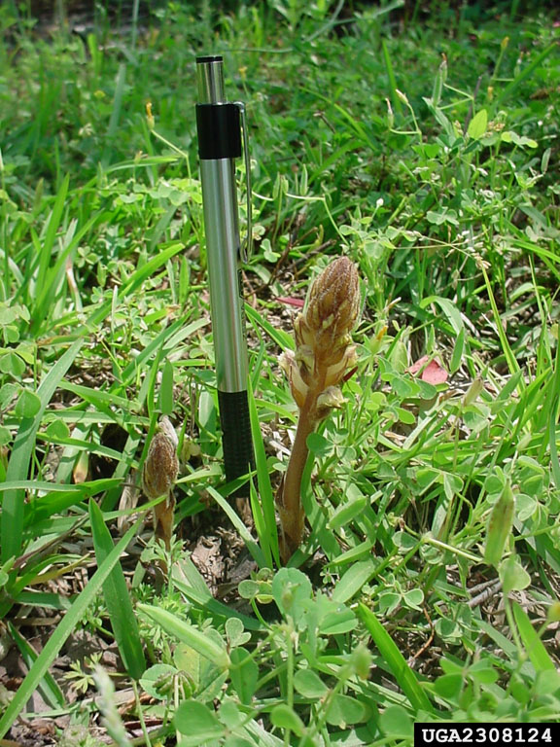
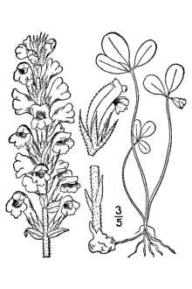
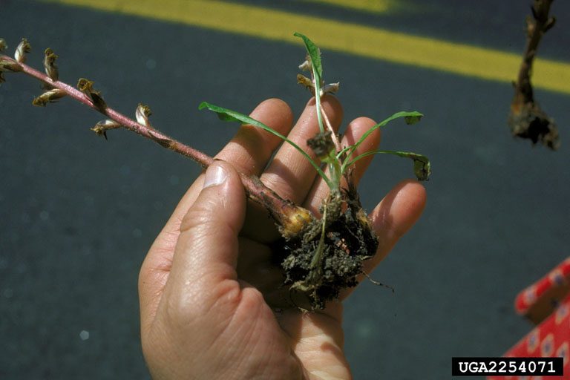
PLANT PARASITES “Broom rape”

Slide 12
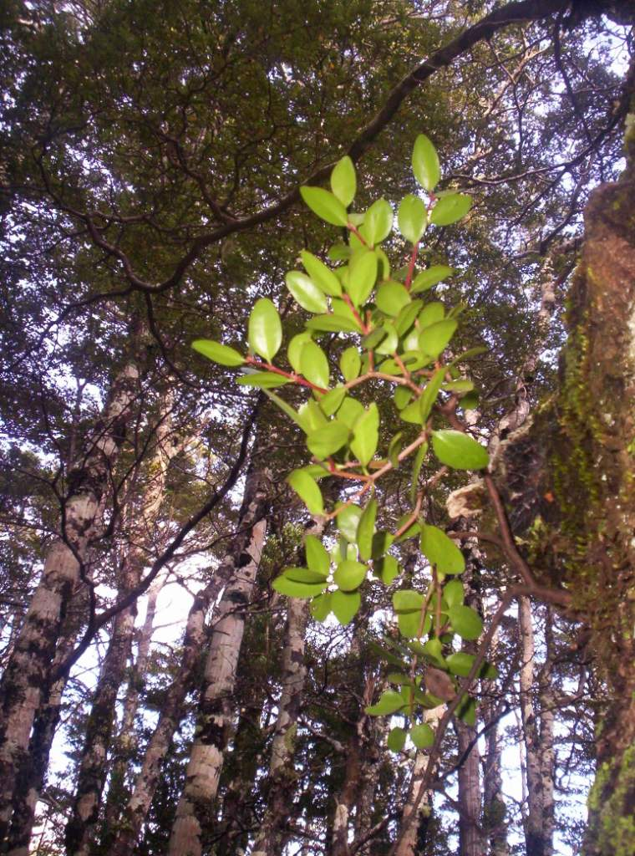
Mistletoe Loranthus

Slide 13
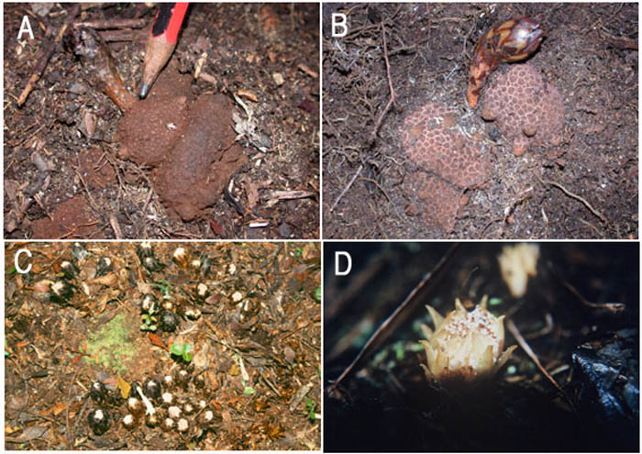
PLANT PARASITES Dactylanthus

Slide 14
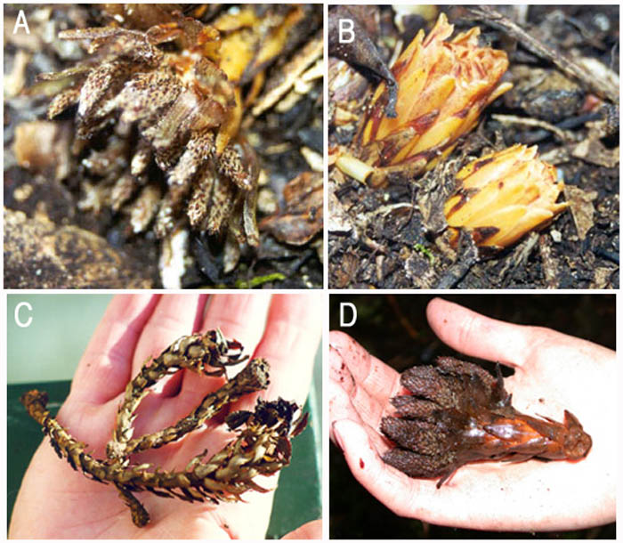
PLANT PARASITES Dactylanthus

Slide 15
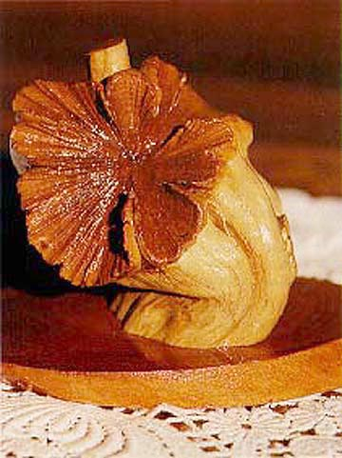
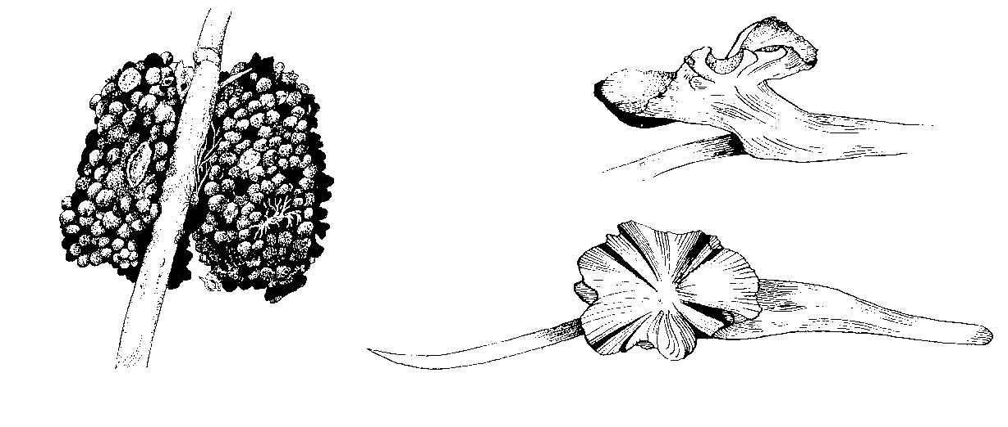
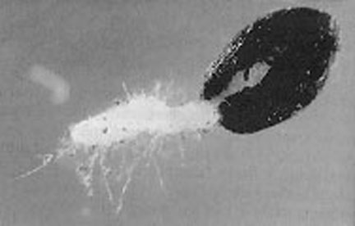
Dactylanthus Wood rose
Seedling of Dactylanthus

Slide 16
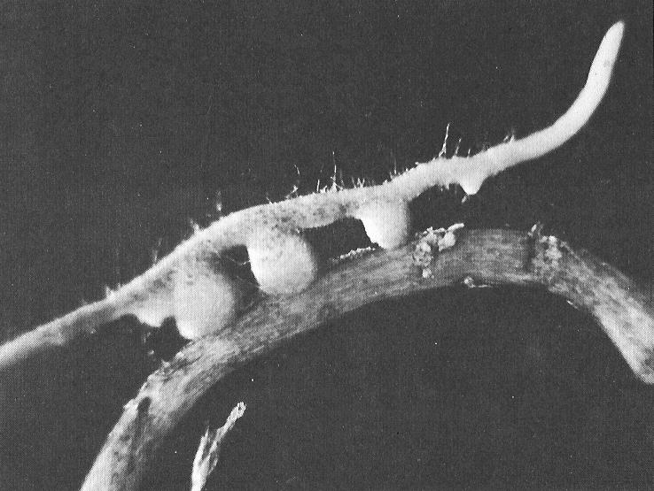
Root parasite Exocarpus haustoria

Slide 17
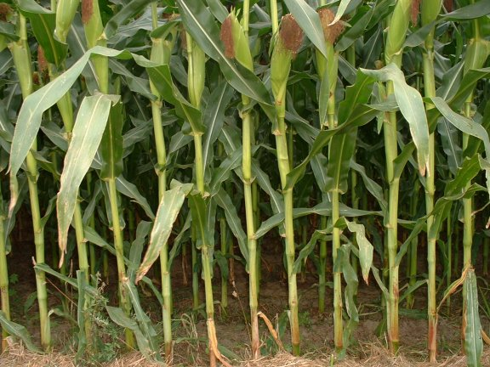
Growing close together for mutual support
Are you ok Jude
Why yes,
Thanks for your support Bev

Slide 18
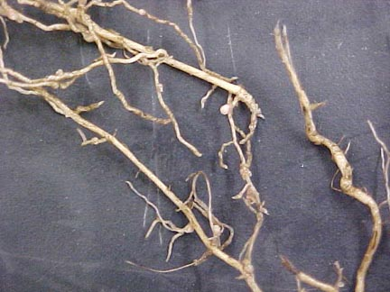
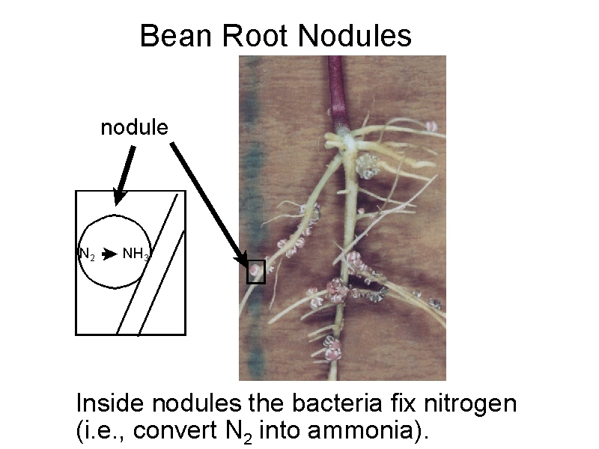
Legume root nodules

Slide 19
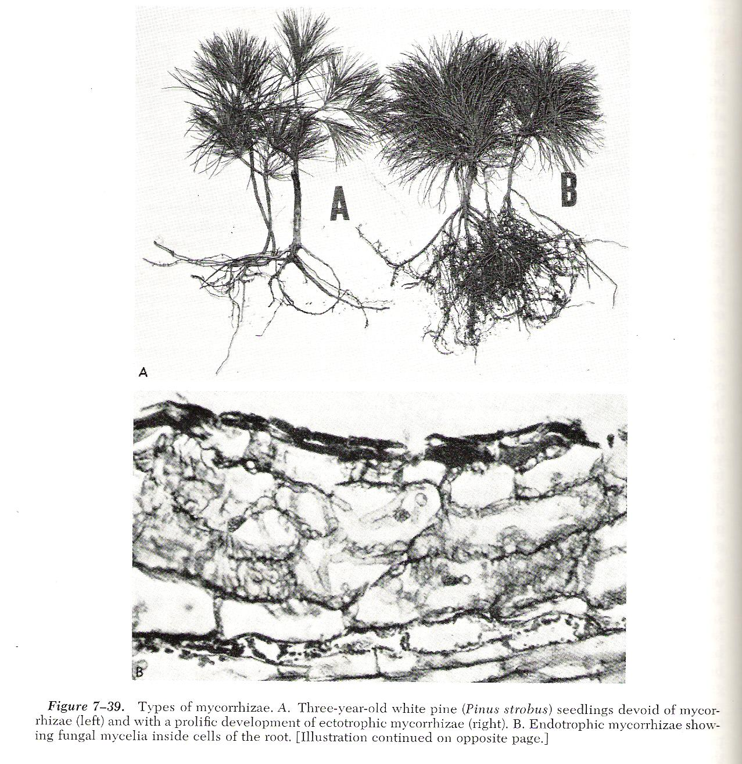
Mycorrhizal fungi extend roots’ ability to absorb water and nutrients

Slide 20
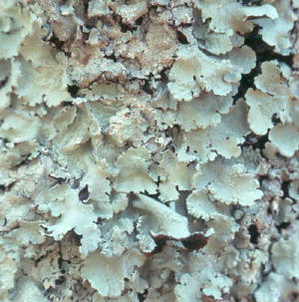
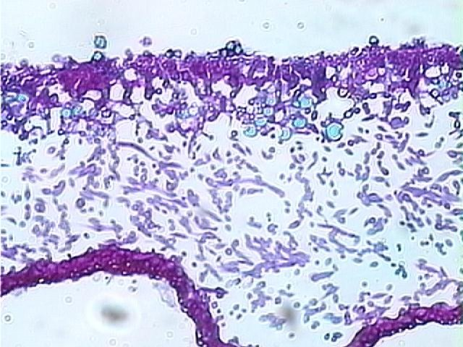
Lichen
Microscope cross section

Slide 21
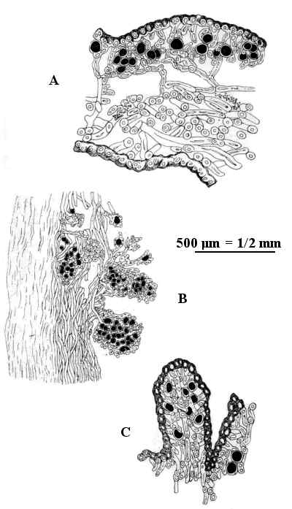
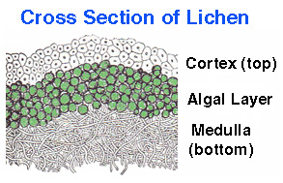
Lichen again

